Slide 1
Centre of Competence
in
Visual Computing
Internship Presentation
Generating melodies with
RNN - LSTM
Mohammed Sadiq Pasha
GuruPrasad Suresh Balehosur

Slide 2
Introduction
Generating melodies with an RNN (Recurrent Neural Network), specifically LSTM (Long Short-Term Memory) networks, is a powerful application of deep learning in music generation. LSTMs, a type of RNN, are particularly well-suited for sequential data, such as music, because they can learn long-range dependencies—essential for creating coherent and musically interesting melodies.
Frameworks for Music Generation:
TensorFlow/Keras: Popular frameworks for building and training LSTM networks. They offer great support for sequential data and building deep learning models.
Music21: library in Python is a powerful and flexible toolkit designed for the analysis, creation, and manipulation of music.
Allows you to analyze musical scores by providing tools for pitch, rhythm, harmony, and form analysis.
It can process music in various formats, such as MusicXML, MIDI, ABC notation, and even Humdrum.
Music21 includes basic visualization capabilities. You can visualize musical scores using standard musical notation (e.g., staff notation) or piano rolls.
The library can parse and create MIDI files, making it easy to manipulate digital music data, extract note sequences, change instruments, or modify rhythms.

Slide 3
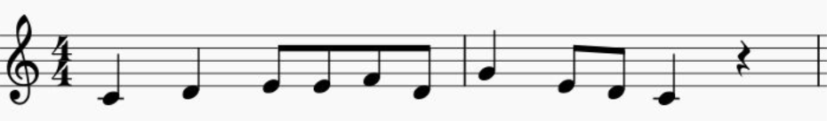
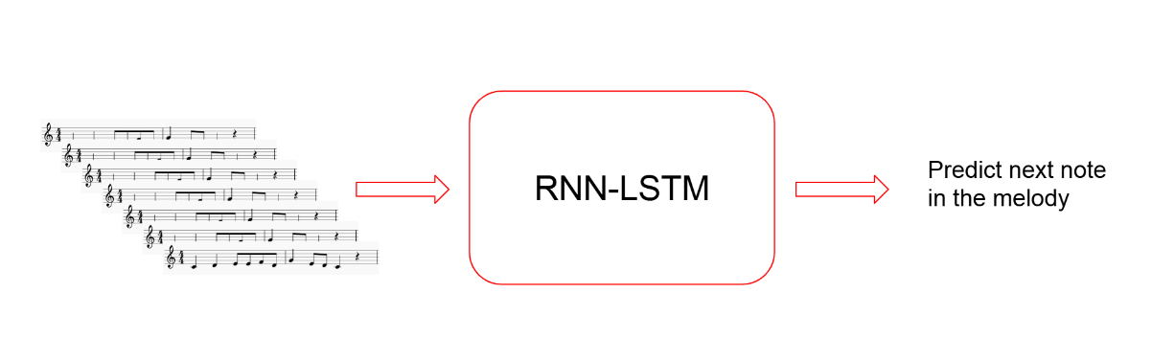
Sequence of notes and rests
The Melody Generator ( Training )

Slide 4
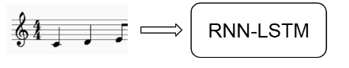
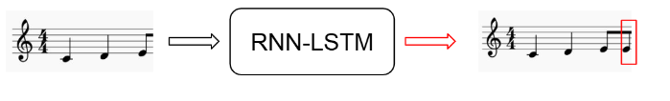
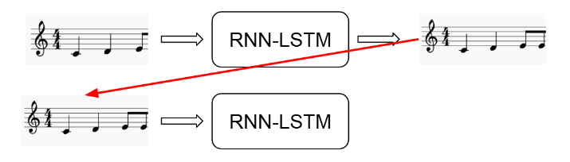
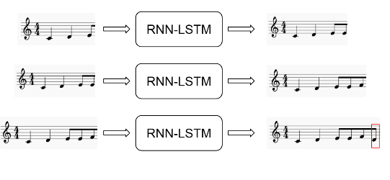
Step – wise Pictorial Representation Of training Of the model

Slide 5
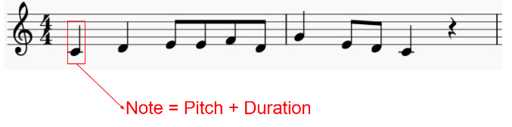
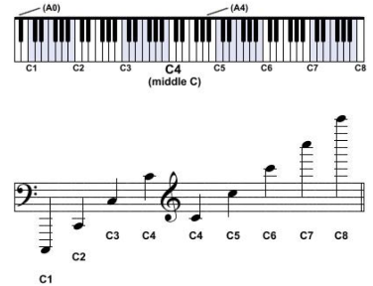
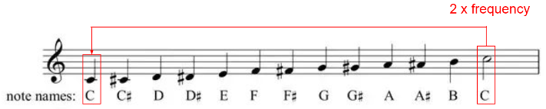
Music Theory Concepts For Melody Generation
Sequence Of notes and rests
Indicates how high / low a note is
Scientific Pitch Notation
Indicates how high / low a note is

Slide 6
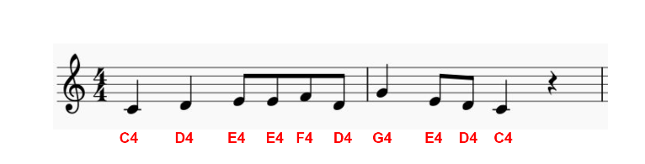
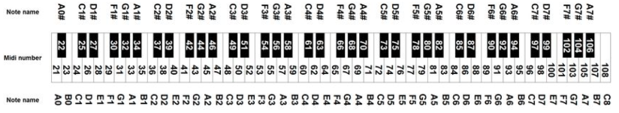
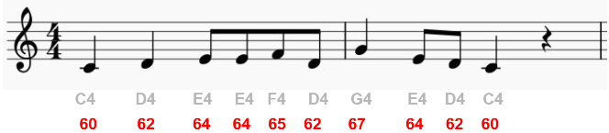
Melody – has its own notes
MIDI note notation
MIDI is a protocol to edit and record music
Map note names to numbers
C4 = 60

Slide 7
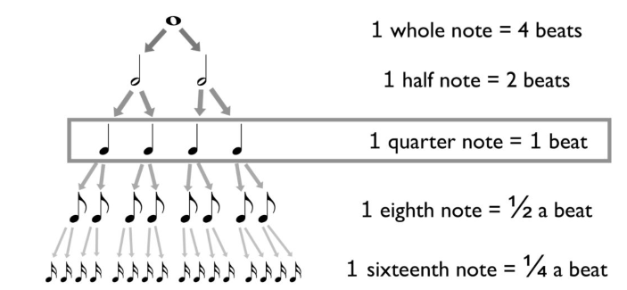
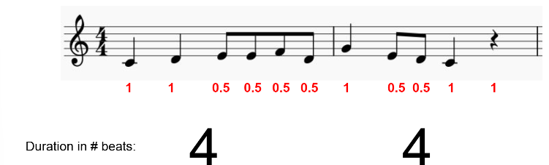
Note Values
Melody

Slide 8
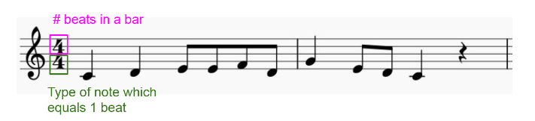
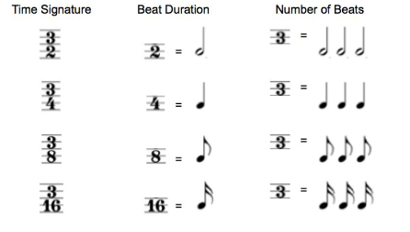
Time Signature

Slide 9
Literature Review - Summary of Key
Findings
RNNs and LSTMs Overview:
RNNs were designed to model sequential data but suffer from limitations like the vanishing gradient problem and inability to capture long-term dependencies.
LSTMs address these issues with their unique gating mechanisms (forget, input, output) and memory cells, enabling better retention of long-range dependencies.
Challenges and Limitations:
Training Complexity: Both RNNs and LSTMs are computationally expensive and difficult to train, especially on long sequences.
Overfitting: LSTMs are prone to overfitting on small or noisy datasets, requiring regularization techniques.
Interpretability: Despite their effectiveness, LSTMs are considered "black-box" models, making them difficult to interpret, particularly in sensitive applications like healthcare or finance.

Slide 10
Research gap
Scalability to Long Sequences:
While LSTMs are effective at handling moderate-length sequences, they still struggle with very long sequences due to memory and computational constraints. Research could explore more efficient methods to handle long-term dependencies, possibly through hybrid models or novel architectures that combine LSTMs with attention mechanisms or transformers.
Model Interpretability:
One major challenge in using LSTMs, especially in high-stakes fields like healthcare and finance, is their lack of interpretability. Developing methods to interpret and visualize the decision-making process of LSTM models could make them more trustworthy and practical for these domains. There is an opportunity to integrate explainability frameworks with LSTM-based models.
Overfitting in Small Datasets:
Overfitting remains a problem, particularly when training LSTM models on small or noisy datasets. Future work could explore more robust training techniques or regularization methods, such as data augmentation or transfer learning, to improve generalization when data is scarce.
Integration of LSTMs with Attention Mechanisms:
While attention mechanisms have been successfully incorporated into transformer models, combining these mechanisms effectively with LSTMs is still an area of exploration. Hybrid models that leverage both the sequential power of LSTMs and the dynamic focus of attention mechanisms could lead to better performance in tasks such as machine translation, speech recognition, and even music generation.

Slide 11
Objective
Objective of this project is to design, develop, and evaluate an LSTM-based model for generating novel musical melodies that mimic the stylistic characteristics of a given dataset of MIDI files. The key objectives to achieve this goal are:
Data Collection and Preprocessing:
To collect and preprocess a comprehensive dataset of MIDI music files, representing various genres or a specific composer’s works, for training the LSTM model. The dataset will be processed into sequences of notes, chords, and corresponding musical events to prepare it for input into the model.
Model Development:
To design and implement a Recurrent Neural Network (RNN) architecture using Long Short-Term Memory (LSTM) cells that can learn and predict musical note sequences based on historical input patterns. The model will include mechanisms to handle varying note durations, pitch, and rhythmic patterns, ensuring a musically coherent output.
Training and Evaluation:
To train the LSTM model on the preprocessed music dataset using backpropagation through time (BPTT) and other training techniques, and evaluate the model's ability to generate melodies that are both creative and musically plausible. Performance metrics like coherence and musical quality will be used to assess output.
Melody Generation:
To implement a melody generation system that can take an initial seed note or phrase and generate a full melody that continues to follow musical patterns learned from the dataset. This system will allow for control over key parameters such as melody length, style, and complexity.

Slide 12
Problem Statement
The generation of original and musically coherent melodies is a challenging task that requires a deep understanding of musical patterns, structure, and creativity. Traditional methods of music composition, while effective, are limited by human constraints and can lack the diversity and unpredictability that AI-driven systems can offer
Current music generation techniques often fail to capture the long-term dependencies and nuanced relationships between musical elements, such as harmony, rhythm, and melody.
This project aims to address the problem of automatic melody generation by leveraging Recurrent Neural Networks (RNNs) and Long Short-Term Memory (LSTM) networks to create a system that can generate novel, stylistically consistent melodies from a given musical dataset.

Slide 13
Dataset Description
Available Datasets: Essen Associative Code and Folksong Database (ESAC)
The Essen Associative Code and Folksong Database (ESAC) is a widely used dataset in the domain of music generation, particularly for training machine learning models to generate melodies and study musical patterns. The database is ideal for projects focused on music analysis, composition, and melody generation, including applications of Recurrent Neural Networks (RNNs) and Long Short-Term Memory (LSTM) networks.
Reasons for Choosing the ESAC Dataset:
Rich Musical Content:
The ESAC dataset contains a diverse collection of folk songs from multiple cultural traditions and historical contexts. It includes melodies with varying rhythmic patterns, harmonic structures, and melodic forms, making it a rich source for training a model capable of generating diverse musical content.
The inclusion of both simple and complex melodies in the dataset allows the model to learn a broad spectrum of musical styles, from basic folk themes to more intricate melodic structures.
MIDI Format for Easy Preprocessing:
The ESAC dataset is available in MIDI format, which is well-suited for machine learning applications, as MIDI provides an easy way to represent musical events (such as pitch, duration, and timing) in a structured, machine-readable format. This enables straightforward preprocessing and transformation of the data into sequences that can be used for training RNN-LSTM models.
MIDI format also allows for precise control over note attributes (such as pitch, velocity, and timing), which is essential for teaching the model to generate melodies with musical accuracy.
Musical Consistency and Structure:
Folk songs, being primarily based on well-established traditions, exhibit consistent rhythmic and melodic structures, which makes them a valuable training set for learning underlying patterns in music. Folk melodies often follow predictable interval structures, common harmonic progressions, and repetitive themes, which can be essential for building an LSTM model that generates coherent, stylistically consistent melodies.
The ESAC database provides an opportunity for the LSTM model to capture both local and global dependencies within the music, such as note-to-note transitions and larger-scale melodic motifs.

Slide 14
.
Data Preprocessing
Step1 - Loading and Filtering Songs
Load_songs_in_kern(dataset_path) load all .krn files (kern format music files) from the dataset path using music21 , Returns a list of music21 stream objects representing the songs
Music in the Kern format may include notes and rests of varying durations, some of which might not be suitable for your specific application, such as training a machine learning model.
By ensuring only acceptable durations (e.g., quarter notes, half notes, etc.), the data is standardized, making it easier to encode and analyze.
Step2 - Transposing Songs
Transpose(song)
Transposes each song to a common key ( C Major for major songs or A Minor for minor songs ) to standardize the data
Transposition is the process of shifting all the notes in a piece of music up or down by the same number of semitones, effectively changing its key
C Major is a natural key with no sharps or flats in its scale.
A Minor is the relative minor of C Major and also lacks sharps or flats.
These keys are often chosen as the "common" keys because they simplify the data by eliminating accidentals (sharps/flats).
Why Transpose to a Common Key?
Standardizing songs to a common key helps in analyzing and comparing musical features without the complexity of varying keys. For example:
It allows machine learning algorithms to focus on patterns in melodies, harmonies, or chord progressions, rather than differences caused by transposition.

Slide 15
Step3 - Encoding Songs ( Why should we Encode ? )
1.Standardizing the Data
Music Representation:
Raw musical data comes in various formats (e.g., MIDI, sheet music, or audio waveforms). These formats are not directly comparable or usable for analysis.
Encoding standardizes music into a consistent symbolic format that is easier to manipulate, analyze, and store.
Time-Step Granularity:
Dividing events into fixed time steps (e.g., 16th notes) ensures a uniform temporal resolution across all songs, regardless of tempo or duration.
2. Preparing for Machine Learning
Discrete Input for Algorithms:
Machine learning models, such as neural networks, often work better with symbolic, time-series data. A string of space-separated symbols like "60 62 r _ 64" (representing note pitches, rests, and sustained notes) can be treated as a sequence or tokenized for input to models like RNNs, LSTMs, or Transformers.
Feature Extraction:
Encoded songs allow extraction of features like note density, pitch variation, or rhythm patterns, which are essential for tasks like genre classification, style transfer, or melody generation.
Sequence Prediction:
Tasks like music generation require sequences as input. The encoded format provides a clear, structured sequence for models to learn from.

Slide 16
Step – 4 Saving Encoded Songs
Once Encoded , the songs are saved as text files , allowing the data to persist even after the programme or session ends . This eliminates the need to re-encode the songs repeatedly , saving computational time and resources
Text files serve as backups that can be easily retrieved , shared or transferred to other systems for further processing
Step – 5 Creating a Single File Dataset
By consolidating multiple files into one , you eliminate the need to individually open and process each song file. This makes the dataset easier to manage and load
A single file is more convenient when working with libraries or frameworks that process data in batches such as TensoFlow
Step – 6 Mapping Symbols to Integers
Machine learning algorithms , especially deep learning models , cant process raw text or symbolic data ( e.g., “60” ,”r” ,”_” ) . They require numerical representations for computation
Mapping symbols to integers converts categorical data into numerical data , making it usable by models
Integer representations are compact and efficient , making the datset easier to process and manage
Saves the mapping as a JSON file ( mapping.json ).
Storing and processing songs as integers is much more efficient than using strings. Integers are lightweight and take up less memory compared to textual symbols, allowing faster computation and reducing storage requirements.

Slide 17
Step - 7 Generating Training Sequences
In tasks like music generation , the model needs to learn patterns in a sequence of data. By splitting the data into smaller sequences, the model can learn these patterns in a manageable way.
In music generation, the model needs to understand the relationship between a sequence of notes (inputs) and the next note (target). This allows it to predict future notes based on past ones.
In sequence prediction tasks, we need the model to learn from previous data points to predict the next one. For example, in music generation, the input might be the notes played so far, and the target is the next note.
By creating input-output pairs, we teach the model how to predict the next element in a sequence given the previous ones.
Example :-
Input Sequence: [60, 64, 67, 62, 64]
Target: 68 (The next note to predict)
The process of generating input-target pairs prepares the data for supervised learning. The model will try to minimize the error between the predicted target and the actual target during training.

Slide 18
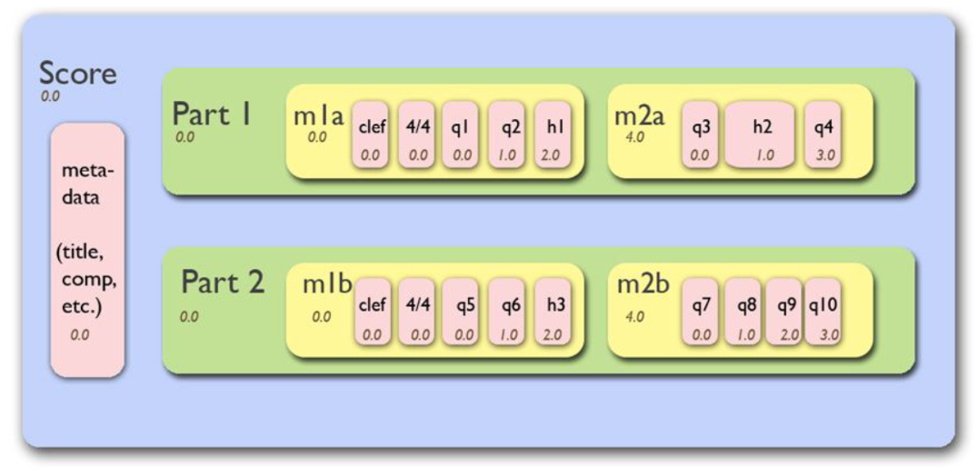
Music21 Score
The image represents the structure of a music21 score object , which consists of multiple Parts , each containing Measures and musical elements such as clefs , time signatures and notes
The Score object at the top level is loaded using the music21.converter.parse() function. Each part (e.g. Part 1, Part 2 ) Corresponds to a track or voice in the music
The load_songs_in_kern() function retrieves these score objects
Inside each measure (e.g., m1a , m2a , m2b) , notes (e.g. q1, h1,q3) and rests are analyzed . Only elements with durations in the ACCEPTABLE_DURATIONS list are kept
Measures or parts containing non-acceptable are excluded from further processing
The key of the Score object (derived from its musical elements ) is used to transpose the entire Score to a common key

Slide 19
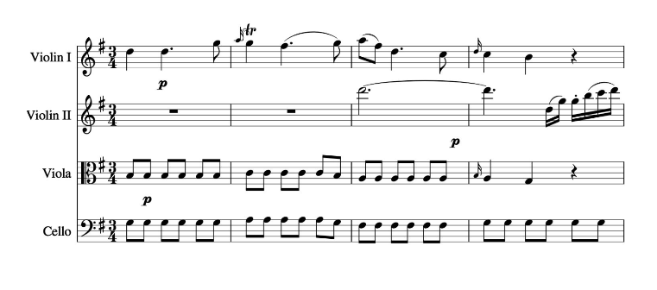
String Quartet

Slide 20
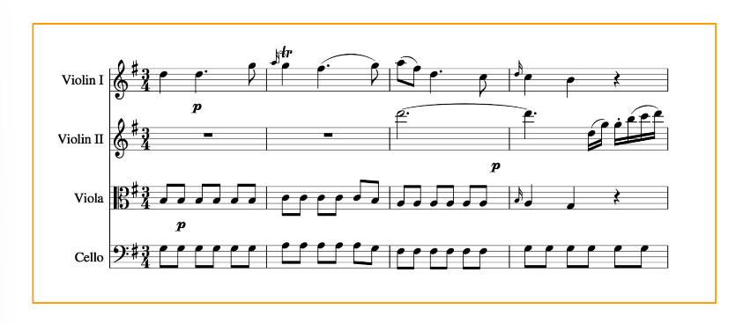
Score

Slide 21
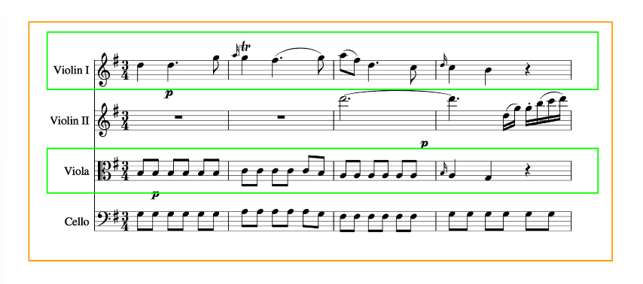
Score + Parts

Slide 22
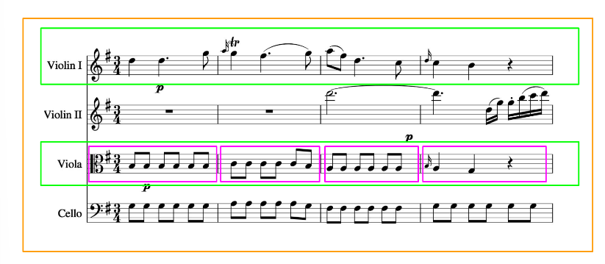
Score + Parts + Measures

Slide 23
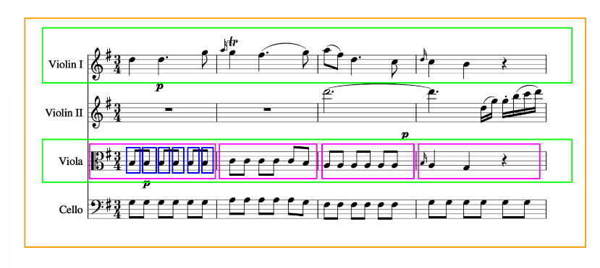
Score + Parts + Measures + Notes

Slide 24
MODEL ARCHITECTURE
Overview of Melody Generation Model
1. High-Level Workflow
Input: Preprocessed melodies encoded as sequences of musical symbols (notes/rests).
Model: LSTM-based neural network.
Output: Melody generated as a sequence of musical symbols.
2. Key Components
Input Layer:
Accepts sequences of encoded musical symbols (one-hot representation).
LSTM Layer:
Captures temporal patterns and dependencies in musical sequences.
Contains 256 units to handle long-term dependencies.
Dropout Layer:
Adds a dropout rate of 0.2 to prevent overfitting.
Dense Output Layer:
Uses a softmax activation function to predict the next symbol in the melody.
Outputs probabilities for 38 possible symbols (vocabulary size).
3. Training Pipeline
Loss Function: Sparse Categorical Crossentropy
Optimized for multi-class classification of symbols.
Optimizer: Adam Optimizer with a learning rate of 0.001.
Data: Sequences generated from music21 Kern dataset with acceptable durations

Slide 25
HYPER PARAMETER TUNING
Hyperparameter tuning involves selecting the optimal set of hyperparameters to improve model performance during training. For your melody generation model, several hyperparameters can influence the learning process and the quality of the generated melodies.
1. Selected Hyperparameters
The following hyperparameters are critical for your model:
a. Learning Rate
Description: Determines the step size used by the optimizer to update weights during backpropagation.
Chosen Value: 0.001
Reason for Tuning: A higher learning rate may cause the model to overshoot the optimal solution, while a lower learning rate might result in slow convergence or getting stuck in local minima.
b. Number of LSTM Units
Description: Refers to the number of memory cells in the LSTM layer.
Chosen Value: 256
Reason for Tuning: Increasing or decreasing the number of LSTM units impacts the model’s ability to learn long-term dependencies. Larger units improve capacity but increase computational complexity and the risk of overfitting.
c. Dropout Rate
Description: Specifies the fraction of neurons to drop during training for regularization.
Chosen Value: 0.2
Reason for Tuning: Adjusting the dropout rate helps balance the trade-off between underfitting (low dropout) and overfitting (high dropout).
d. Sequence Length
Description: Determines the number of previous notes (steps) used as input to predict the next note.
Chosen Value: SEQUENCE_LENGTH
Reason for Tuning: Longer sequences provide more context but may increase computational load and risk overfitting.
e. Temperature (used during melody generation)
Description: Controls the randomness of predictions during melody generation by scaling the logits before applying softmax.
Chosen Value: 0.7
Reason for Tuning: Lower values make the model more deterministic, while higher values introduce more randomness. Tuning this helps strike a balance between creativity and coherence.

Slide 26
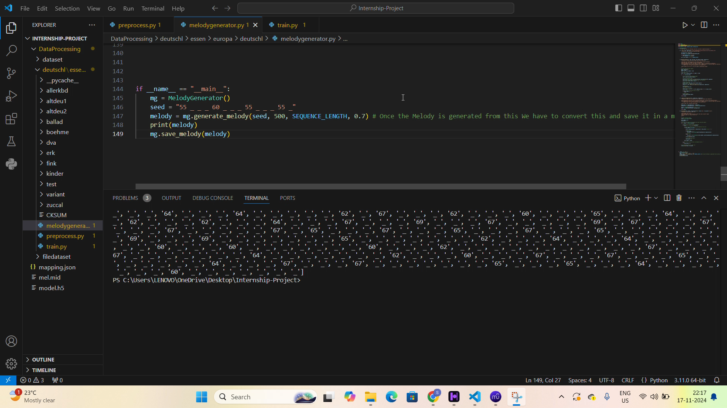
IMPLEMENTATION OF THE PROJECT

Slide 27
REFERENCES
Hochreiter, S. (1991). "Untersuchungen zu dynamischen neuronalen Netzen", Diploma Thesis, Technical University of Munich.
Pascanu, R., Mikolov, T., & Bengio, Y. (2013). "Understanding the Difficulty of Training Recurrent Neural Networks". ICML.
Graves, A., et al. (2013). "Speech recognition with deep recurrent neural networks", IEEE International Conference on Acoustics, Speech, and Signal Processing.
Sutskever, I., et al. (2014). "Sequence to Sequence Learning with Neural Networks", NIPS.
Vaswani, A., et al. (2017). "Attention is All You Need", NeurIPS.

